Slide 1
Numerical Techniques in Linear Algebra
Numerical Methods by Chapra: Chapter 10 & 11
Numerical Analysis by Burden: Chapter 6 & 7

Slide 2
Numerical Techniques to Solve System of Linear Equations
Iterative Techniques
Method of LU Factorization
Gauss Elimination Method

Slide 3
Iterative Techniques Numerical Methods by Chapra: Chapter 11 Numerical Analysis by Burden: Chapter 7
Jacobi Iterative Technique
Gauss-Seidel Iterative Technique

Slide 4
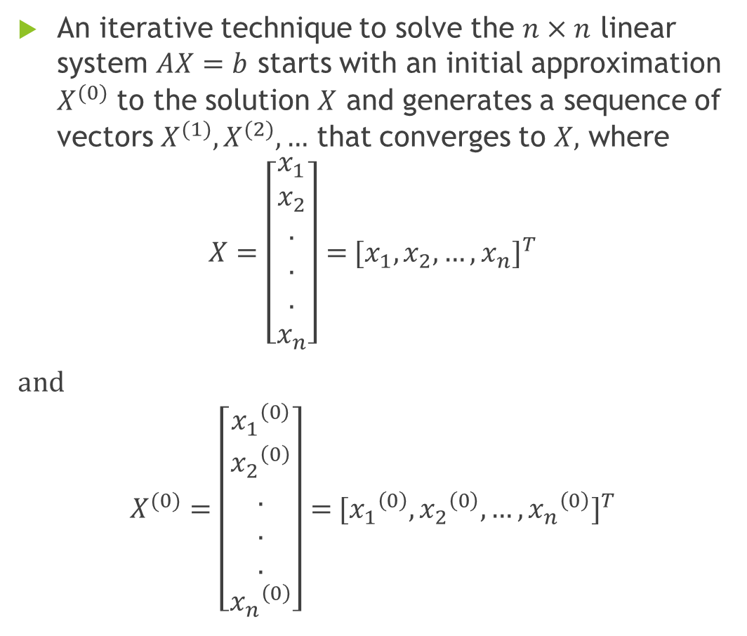
Iterative Technique
An iterative technique to solve the $n×n$ linear system $AX=b$ starts with an initial approximation $X^{(0)}$ to the solution $X$ and generates a sequence of vectors $X^{(1)},X^{(2)},…$ that converges to $X,$ where
$$X=\left[\begin{aligned}x_{1} \\ x_{2} \\ . \\ . \\ . \\ x_{n}\end{aligned}\right]={ [x_{1},x_{2},…,x_{n}]}^{T}$$
and
$$X^{(0)}=\left[\begin{aligned}{x_{1}}^{\left(0\right)} \\ {x_{2}}^{\left(0\right)} \\ . \\ . \\ . \\ {x_{n}}^{\left(0\right)}\end{aligned}\right]={ [{x_{1}}^{\left(0\right)},{x_{2}}^{\left(0\right)},…,{x_{n}}^{\left(0\right)}]}^{T}$$

Slide 5
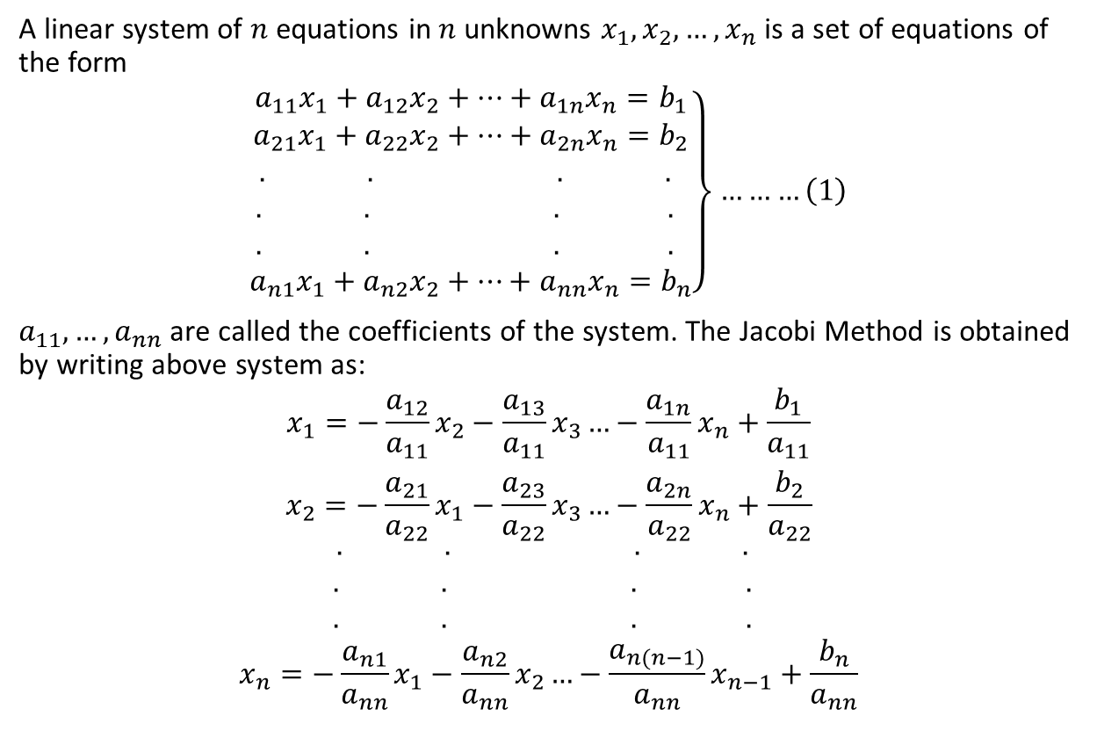
1.Jacobi Iterative Technique
A linear system of $n$ equations in $n$ unknowns $x_{1},x_{2},…,x_{n}$ is a set of equations of the form
$$\left.\begin{aligned}a_{11}x_{1}+a_{12}x_{2}+…+a_{1n}x_{n}=b_{1} \\ a_{21}x_{1}+a_{22}x_{2}+…+a_{2n}x_{n}=b_{2} \\ . . . . \\ . . . . \\ . . . . \\ a_{n1}x_{1}+a_{n2}x_{2}+…+a_{nn}x_{n}=b_{n}\end{aligned}\right\}………\left(1\right)$$
$a_{11},…,a_{nn}$ are called the coefficients of the system. The Jacobi Method is obtained by writing above system as:
$$\begin{aligned}x_{1}=−\frac{a_{12}}{a_{11}}x_{2}−\frac{a_{13}}{a_{11}}x_{3}…−\frac{a_{1n}}{a_{11}}x_{n}+\frac{b_{1}}{a_{11}} \\ x_{2}=−\frac{a_{21}}{a_{22}}x_{1}−\frac{a_{23}}{a_{22}}x_{3}…−\frac{a_{2n}}{a_{22}}x_{n}+\frac{b_{2}}{a_{22}} \\ . . . . \\ . . . . \\ . . . . \\ x_{n}=−\frac{a_{n1}}{a_{nn}}x_{1}−\frac{a_{n2}}{a_{nn}}x_{2}…−\frac{a_{n(n−1)}}{a_{nn}}x_{n−1}+\frac{b_{n}}{a_{nn}}\end{aligned}$$

Slide 6
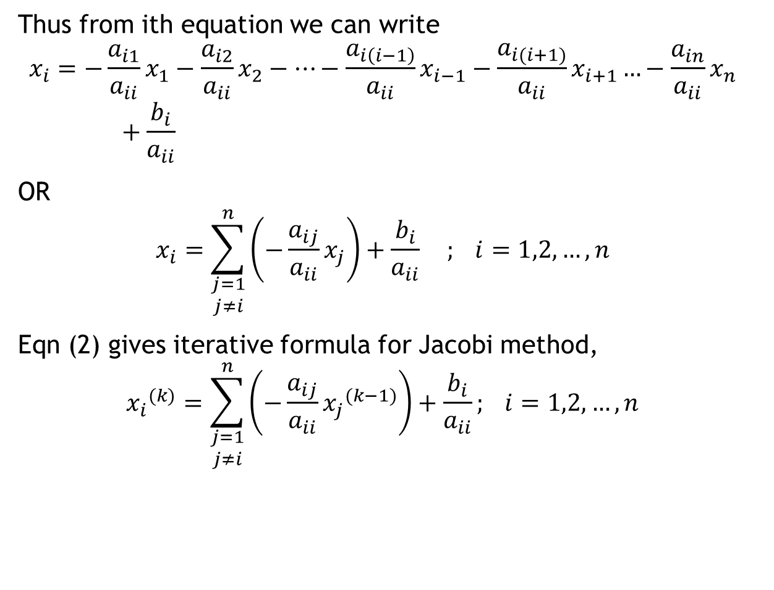
Thus from ith equation we can write
$$x_{i}=−\frac{a_{i1}}{a_{ii}}x_{1}−\frac{a_{i2}}{a_{ii}}x_{2}−…−\frac{a_{i\left(i−1\right)}}{a_{ii}}x_{i−1}−\frac{a_{i(i+1)}}{a_{ii}}x_{i+1}…−\frac{a_{in}}{a_{ii}}x_{n}+\frac{b_{i}}{a_{ii}}$$
OR
$$x_{i}=\sum_{\begin{aligned}j=1 \\ j≠i\end{aligned}}^{n}{\left(−\frac{a_{ij}}{a_{ii}}x_{j}\right)}+\frac{b_{i}}{a_{ii}} ; i=1,2,…,n$$
Eqn (2) gives iterative formula for Jacobi method,
$${x_{i}}^{(k)}=\sum_{\begin{aligned}j=1 \\ j≠i\end{aligned}}^{n}{\left(−\frac{a_{ij}}{a_{ii}}{x_{j}}^{(k−1)}\right)}+\frac{b_{i}}{a_{ii}}; i=1,2,…,n$$
(2)
(3)

Slide 7
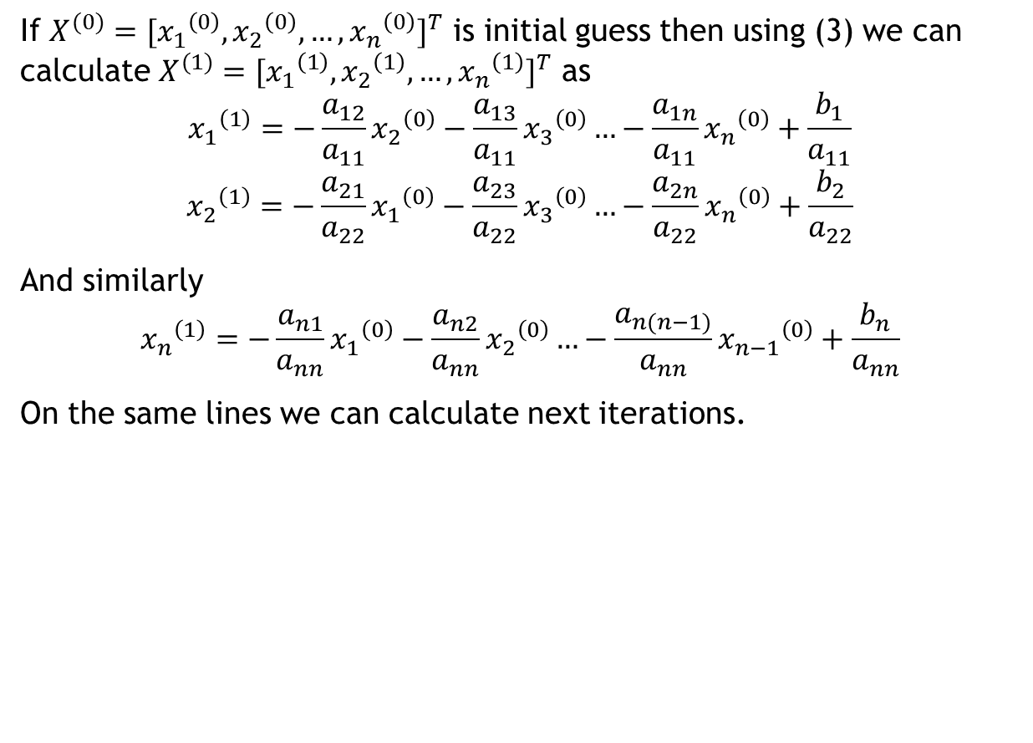
If $X^{(0)}{=[{x_{1}}^{\left(0\right)},{x_{2}}^{\left(0\right)},…,{x_{n}}^{\left(0\right)}]}^{T}$ is initial guess then using (3) we can calculate $X^{(1)}{=[{x_{1}}^{\left(1\right)},{x_{2}}^{\left(1\right)},…,{x_{n}}^{\left(1\right)}]}^{T}$ as
$${x_{1}}^{\left(1\right)}=−\frac{a_{12}}{a_{11}}{x_{2}}^{\left(0\right)}−\frac{a_{13}}{a_{11}}{x_{3}}^{\left(0\right)}…−\frac{a_{1n}}{a_{11}}{x_{n}}^{\left(0\right)}+\frac{b_{1}}{a_{11}}$$
$${x_{2}}^{\left(1\right)}=−\frac{a_{21}}{a_{22}}{x_{1}}^{\left(0\right)}−\frac{a_{23}}{a_{22}}{x_{3}}^{\left(0\right)}…−\frac{a_{2n}}{a_{22}}{x_{n}}^{\left(0\right)}+\frac{b_{2}}{a_{22}}$$
And similarly
$${x_{n}}^{\left(1\right)}=−\frac{a_{n1}}{a_{nn}}{x_{1}}^{\left(0\right)}−\frac{a_{n2}}{a_{nn}}{x_{2}}^{\left(0\right)}…−\frac{a_{n(n−1)}}{a_{nn}}{x_{n−1}}^{\left(0\right)}+\frac{b_{n}}{a_{nn}}$$
On the same lines we can calculate next iterations.

Slide 8
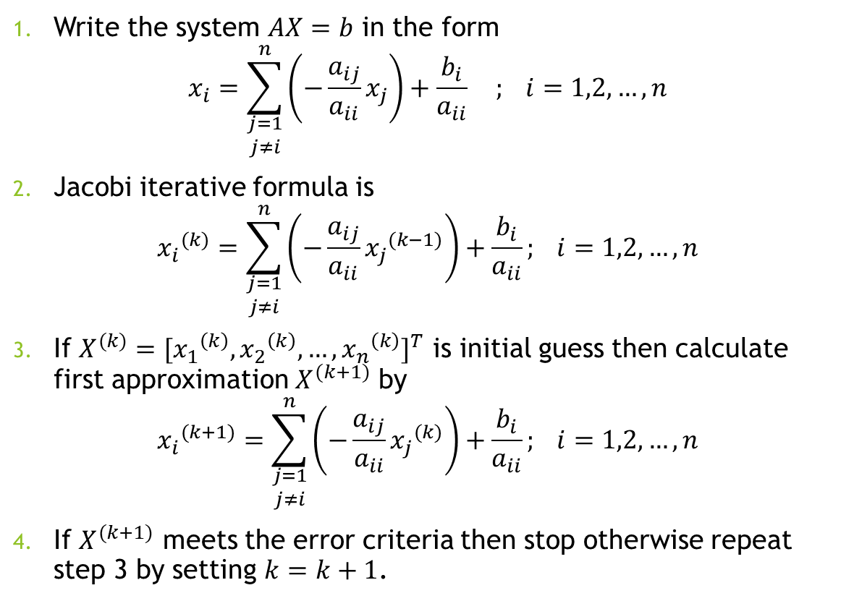
Algorithm
Write the system $AX=b$ in the form
$$x_{i}=\sum_{\begin{aligned}j=1 \\ j≠i\end{aligned}}^{n}{\left(−\frac{a_{ij}}{a_{ii}}x_{j}\right)}+\frac{b_{i}}{a_{ii}} ; i=1,2,…,n$$
Jacobi iterative formula is
$${x_{i}}^{(k)}=\sum_{\begin{aligned}j=1 \\ j≠i\end{aligned}}^{n}{\left(−\frac{a_{ij}}{a_{ii}}{x_{j}}^{(k−1)}\right)}+\frac{b_{i}}{a_{ii}}; i=1,2,…,n$$
If $X^{(k)}{=[{x_{1}}^{\left(k\right)},{x_{2}}^{\left(k\right)},…,{x_{n}}^{\left(k\right)}]}^{T}$ is initial guess then calculate first approximation $X^{(k+1)}$ by
$${x_{i}}^{(k+1)}=\sum_{\begin{aligned}j=1 \\ j≠i\end{aligned}}^{n}{\left(−\frac{a_{ij}}{a_{ii}}{x_{j}}^{(k)}\right)}+\frac{b_{i}}{a_{ii}}; i=1,2,…,n$$
If $X^{(k+1)}$ meets the error criteria then stop otherwise repeat step 3 by setting $k=k+1$.

Slide 9
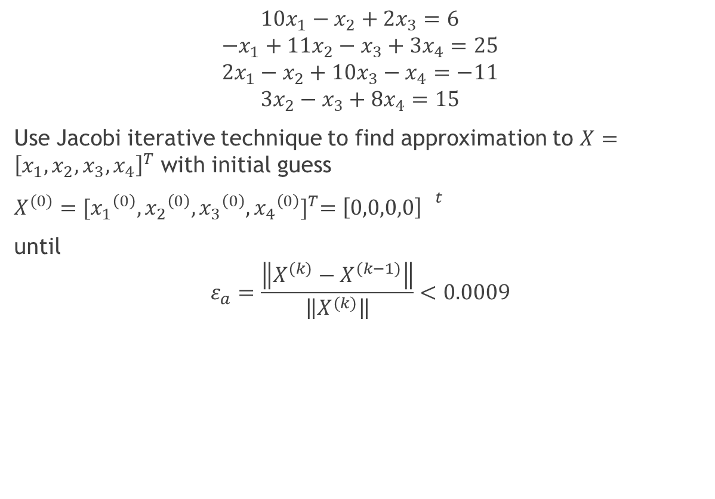
Example
$$10x_{1}−x_{2}+2x_{3}=6$$
$$−x_{1}+11x_{2}−x_{3}+3x_{4}=25$$
$$2x_{1}−x_{2}+10x_{3}−x_{4}=−11$$
$$3x_{2}−x_{3}+8x_{4}=15$$
Use Jacobi iterative technique to find approximation to $X={\left[x_{1},x_{2},x_{3},x_{4}\right]}^{T}$ with initial guess
$X^{(0)}{=[{x_{1}}^{\left(0\right)},{x_{2}}^{\left(0\right)},{x_{3}}^{\left(0\right)},{x_{4}}^{\left(0\right)}]}^{T}={\left[0,0,0,0\right] }^{t}$
until
$$ε_{a}=\frac{\left\|X^{(k)}−X^{(k−1)}\right\|}{\left\|X^{(k)}\right\|}<0.0009$$

Slide 10
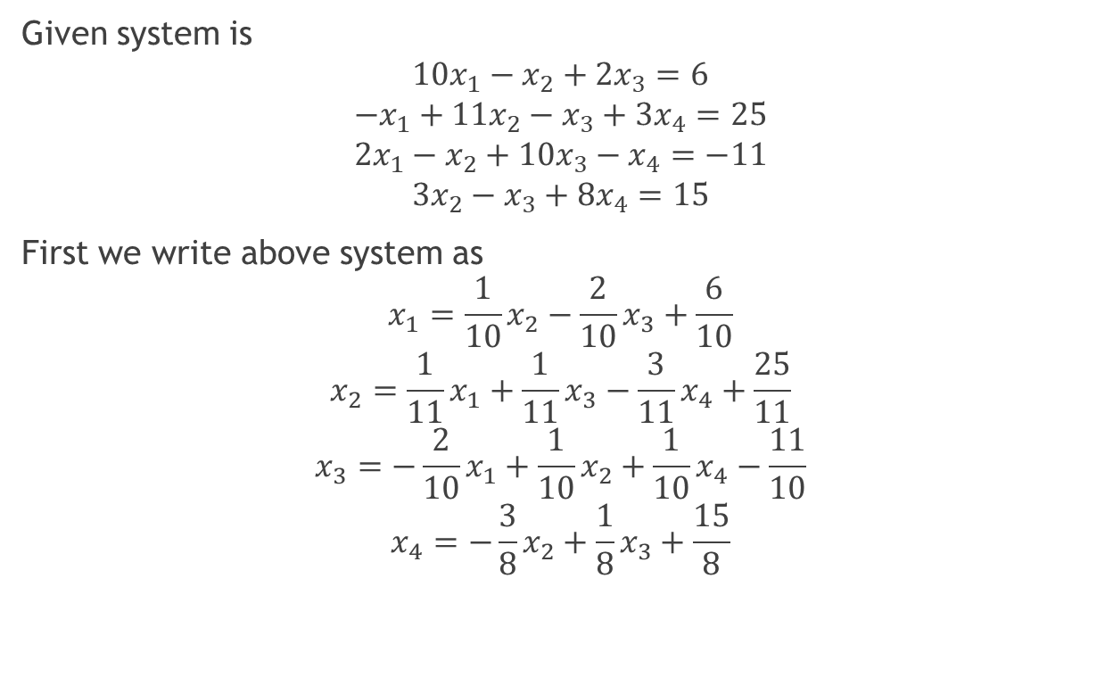
Solution
Given system is
$$10x_{1}−x_{2}+2x_{3}=6$$
$$−x_{1}+11x_{2}−x_{3}+3x_{4}=25$$
$$2x_{1}−x_{2}+10x_{3}−x_{4}=−11$$
$$3x_{2}−x_{3}+8x_{4}=15$$
First we write above system as
$$x_{1}=\frac{1}{10}x_{2}−\frac{2}{10}x_{3}+\frac{6}{10}$$
$$x_{2}=\frac{1}{11}x_{1}+\frac{1}{11}x_{3}−\frac{3}{11}x_{4}+\frac{25}{11}$$
$$x_{3}=−\frac{2}{10}x_{1}+\frac{1}{10}x_{2}+\frac{1}{10}x_{4}−\frac{11}{10}$$
$$x_{4}=−\frac{3}{8}x_{2}+\frac{1}{8}x_{3}+\frac{15}{8}$$
1st Eqn implies
2nd Eqn implies
3rd Eqn implies
4th Eqn implies

Slide 11
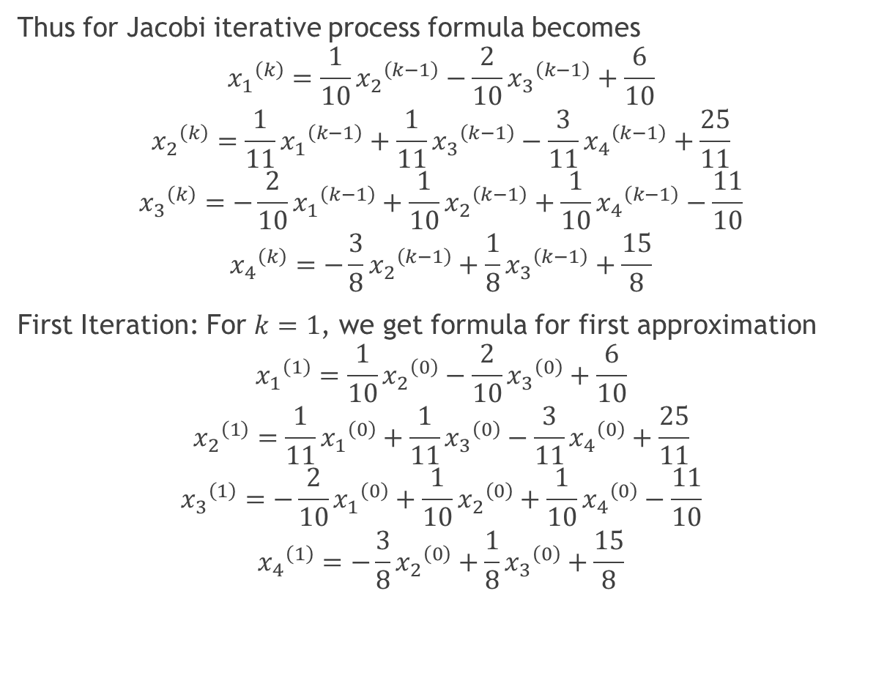
Thus for Jacobi iterative process formula becomes
$${x_{1}}^{\left(k\right)}=\frac{1}{10}{x_{2}}^{\left(k−1\right)}−\frac{2}{10}{x_{3}}^{\left(k−1\right)}+\frac{6}{10}$$
$${x_{2}}^{\left(k\right)}=\frac{1}{11}{x_{1}}^{\left(k−1\right)}+\frac{1}{11}{x_{3}}^{\left(k−1\right)}−\frac{3}{11}{x_{4}}^{\left(k−1\right)}+\frac{25}{11}$$
$${x_{3}}^{\left(k\right)}=−\frac{2}{10}{x_{1}}^{\left(k−1\right)}+\frac{1}{10}{x_{2}}^{\left(k−1\right)}+\frac{1}{10}{x_{4}}^{\left(k−1\right)}−\frac{11}{10}$$
$${x_{4}}^{\left(k\right)}=−\frac{3}{8}{x_{2}}^{\left(k−1\right)}+\frac{1}{8}{x_{3}}^{\left(k−1\right)}+\frac{15}{8}$$
First Iteration: For $k=1$, we get formula for first approximation
$${x_{1}}^{\left(1\right)}=\frac{1}{10}{x_{2}}^{\left(0\right)}−\frac{2}{10}{x_{3}}^{\left(0\right)}+\frac{6}{10}$$
$${x_{2}}^{\left(1\right)}=\frac{1}{11}{x_{1}}^{\left(0\right)}+\frac{1}{11}{x_{3}}^{\left(0\right)}−\frac{3}{11}{x_{4}}^{\left(0\right)}+\frac{25}{11}$$
$${x_{3}}^{\left(1\right)}=−\frac{2}{10}{x_{1}}^{\left(0\right)}+\frac{1}{10}{x_{2}}^{\left(0\right)}+\frac{1}{10}{x_{4}}^{\left(0\right)}−\frac{11}{10}$$
$${x_{4}}^{\left(1\right)}=−\frac{3}{8}{x_{2}}^{\left(0\right)}+\frac{1}{8}{x_{3}}^{\left(0\right)}+\frac{15}{8}$$

Slide 12
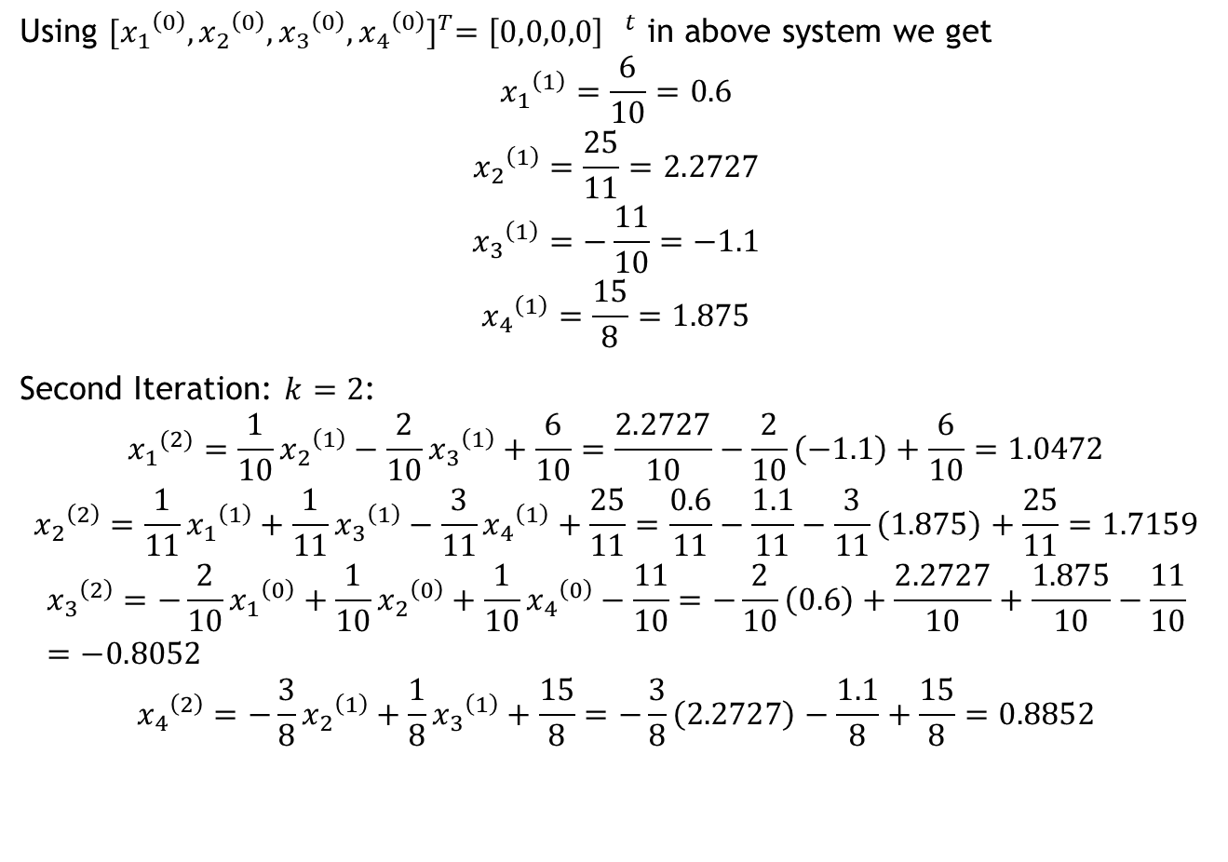
Using ${[{x_{1}}^{\left(0\right)},{x_{2}}^{\left(0\right)},{x_{3}}^{\left(0\right)},{x_{4}}^{\left(0\right)}]}^{T}={\left[0,0,0,0\right] }^{t}$ in above system we get
$${x_{1}}^{\left(1\right)}=\frac{6}{10}=0.6$$
$${x_{2}}^{\left(1\right)}=\frac{25}{11}=2.2727$$
$${x_{3}}^{\left(1\right)}=−\frac{11}{10}=−1.1$$
$${x_{4}}^{\left(1\right)}=\frac{15}{8}=1.875$$
Second Iteration: $k=2$:
$${x_{1}}^{(2)}=\frac{1}{10}{x_{2}}^{\left(1\right)}−\frac{2}{10}{x_{3}}^{\left(1\right)}+\frac{6}{10}=\frac{2.2727}{10}−\frac{2}{10}\left(−1.1\right)+\frac{6}{10}=1.0472$$
$${x_{2}}^{\left(2\right)}=\frac{1}{11}{x_{1}}^{\left(1\right)}+\frac{1}{11}{x_{3}}^{\left(1\right)}−\frac{3}{11}{x_{4}}^{\left(1\right)}+\frac{25}{11}=\frac{0.6}{11}−\frac{1.1}{11}−\frac{3}{11}\left(1.875\right)+\frac{25}{11}=1.7159$$
$${x_{3}}^{\left(2\right)}=−\frac{2}{10}{x_{1}}^{\left(0\right)}+\frac{1}{10}{x_{2}}^{\left(0\right)}+\frac{1}{10}{x_{4}}^{\left(0\right)}−\frac{11}{10}=−\frac{2}{10}\left(0.6\right)+\frac{2.2727}{10}+\frac{1.875}{10}−\frac{11}{10}=−0.8052$$
$${x_{4}}^{\left(2\right)}=−\frac{3}{8}{x_{2}}^{\left(1\right)}+\frac{1}{8}{x_{3}}^{\left(1\right)}+\frac{15}{8}=−\frac{3}{8}\left(2.2727\right)−\frac{1.1}{8}+\frac{15}{8}=0.8852$$

Slide 13
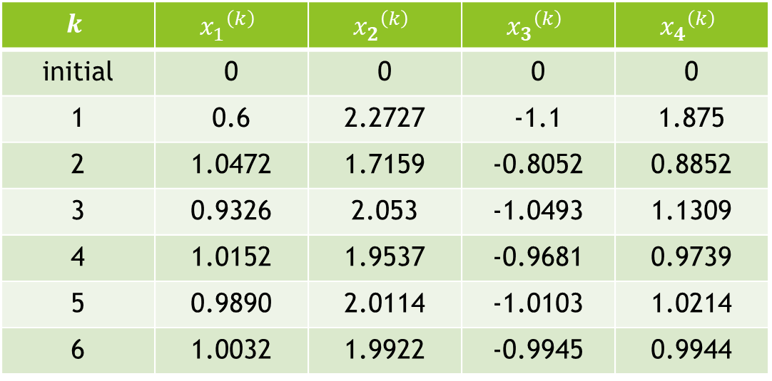
We can perform iteration in a table
$$k$$ | $${x_{1}}^{\left(k\right)}$$ | $${x_{2}}^{\left(k\right)}$$ | $${x_{3}}^{\left(k\right)}$$ | $${x_{4}}^{\left(k\right)}$$
initial | 0 | 0 | 0 | 0
1 | 0.6 | 2.2727 | -1.1 | 1.875
2 | 1.0472 | 1.7159 | -0.8052 | 0.8852
3 | 0.9326 | 2.053 | -1.0493 | 1.1309
4 | 1.0152 | 1.9537 | -0.9681 | 0.9739
5 | 0.9890 | 2.0114 | -1.0103 | 1.0214
6 | 1.0032 | 1.9922 | -0.9945 | 0.9944

Slide 14

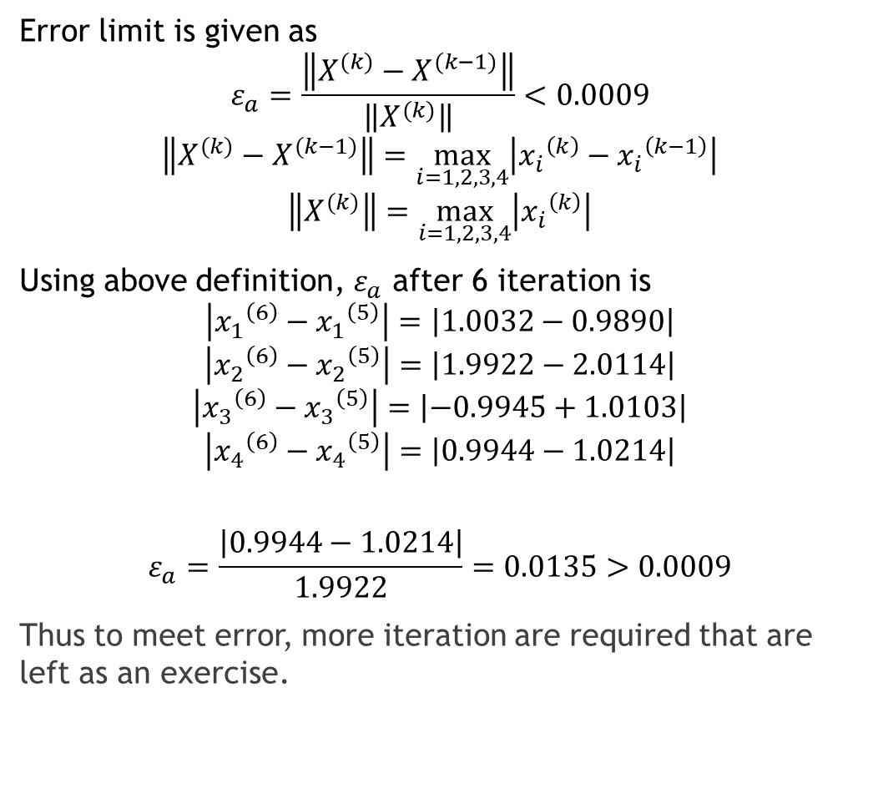
Error limit is given as
$$ε_{a}=\frac{\left\|X^{(k)}−X^{(k−1)}\right\|}{\left\|X^{(k)}\right\|}<0.0009$$
$$\left\|X^{(k)}−X^{(k−1)}\right\|=\max_{i=1,2,3,4}\left|{x_{i}}^{\left(k\right)}−{x_{i}}^{\left(k−1\right)}\right|$$
$$\left\|X^{(k)}\right\|=\max_{i=1,2,3,4}\left|{x_{i}}^{\left(k\right)}\right|$$
Using above definition, $ε_{a}$ after 6 iteration is
$$\left|{x_{1}}^{\left(6\right)}−{x_{1}}^{\left(5\right)}\right|=\left|1.0032−0.9890\right|$$
$$\left|{x_{2}}^{\left(6\right)}−{x_{2}}^{\left(5\right)}\right|=\left|1.9922−2.0114\right|$$
$$\left|{x_{3}}^{\left(6\right)}−{x_{3}}^{\left(5\right)}\right|=\left|−0.9945+1.0103\right|$$
$$\left|{x_{4}}^{\left(6\right)}−{x_{4}}^{\left(5\right)}\right|=\left|0.9944−1.0214\right|$$
$$ε_{a}=\frac{\left|0.9944−1.0214\right|}{1.9922}=0.0135>0.0009$$
Thus to meet error, more iteration are required that are left as an exercise.
$$\left|{x_{1}}^{\left(k\right)}−{x_{1}}^{\left(k−1\right)}\right|$$
$$\left|{x_{2}}^{\left(k\right)}−{x_{2}}^{\left(k−1\right)}\right|$$
$$\left|{x_{3}}^{\left(k\right)}−{x_{3}}^{\left(k−1\right)}\right|$$
$$\left|{x_{4}}^{\left(k\right)}−{x_{4}}^{\left(k−1\right)}\right|$$

